Slide 1
Case Study: Internet Banking Platform

Slide 2

Unique Bank
Global Presence: Operates across 28 markets, with a strong base in APAC and EMEA regions.
Regional Focus: Strategically positioned to capitalize shifting focus on emerging markets Asia and ME
Leader in Digital Transformation: Recognized for being forefront of digital transformation in finance sector
Commitment to Sustainability: Actively support social entrepreneur to develop innovative solution for sustainability challenges.

Slide 3
Our Understanding
Current system is legacy-based and built on off-the-shelf products
Customers are happy with the current system, but new features and modern technology are necessary for competitiveness
Business Goals
Current State Analysis
Build a new best-in class Retail Internet Banking platform using the latest technologies
Custom software solution replacing the existing commercial product
Focus on delivering a rich user experience and Responsive design, scalable system, and modern navigation
Seamless migration process for existing users

Slide 4
Solution Highlights:
Human Centric design for UI:
A modern engaging and intuitive interface, prioritizing a delightful user experience driven by human centric principles
API first approach:
An API first design philosophy to ensure well structured and interoperable interfaces.
Modular and decoupled by choice:
A modular and decoupled architecture and design to enhance scalability and maintainability
Secure by design:
A security first architecture pioneering prudent principle of least privilege
Improved auditing exception handling and resilience:
Implement robust auditing, exception handling mechanisms and resilience strategies to minimize service disruptions.
Increased agility:
Greater agility to swiftly adapt to changing demands and market dynamics by implementing agile development methodologies.
Accelerated release cycles:
Streamline release cycles using DevOps implementation to facilitate rapid updates, testing and alignment with evolving requirements.
Reduced technical debt and vulnerabilities:
Reduction in technical debts in the new state of the art architecture implemented using cutting edge technologies.
In house tools and accelerators:
Leverage our proven digital expertise, innovative thought leadership, unique partnership and exclusive tools to expediate and optimize digital modernization

Slide 5
Solution Value Proposition:
Why
How (Our Vision)
Who, When, Where, What
Gain Competitive advantage
Reliable Data driven insights
Trusted partner to support future roadmap
Agile & Flexible Infrastructure
Setup VNet in Azure for DEV, Test, Prod & DR
Monitor and Manage Infrastructure & Apps (Azure Monitor)
ITSM tool integration with Helpdesk (ServiceNow, Azure Service Manager)
ABC Inc as your Trusted Partner to support your envisioned Transformational Roadmap Implementing a Scalable state of the art Web -Portal, Mobile App with Chat Bot
Implementation to conclude in 12 Months and support to run in parallel for 3Y
Having Integrated Tools across IT Infrastructure, ITSM, Network, Testing, DevSecOps & Monitoring & management
Streamlined Governance, with Ownership and accountability during the Support Phase
Enrich business user experience while accessing Web Portal & Mobile App with No disruption to existing services
Business
Legacy infrastructure with limited flexibility
Limited standardization
Need for new technology adaption
Portal and infra to be able to Scaleup
Enhance User Experience
Design and Implement a Web portal and Mobile App using suggested front & backend technologies for the use cases aligned to Motor insurance LoB
The portal enables Chatbot with Live Agent functionality through Azure native Bot services
Technology
Need for Integrated User Experience for Stakeholders while accessing Web portals and mobile application
Standardized Data & Improvise Reports
Standardize and Migrate historical data and content to Azure native Data store
User
Stable & Secure Operations
Co-creation of SLA's. OLA's & KPI
Simplified Operating model & Governance with Ownership and accountability
24x7 support for Web-portal & Mobile App catering to L1/2/3 support
Managed services for Infra & Apps
Cost efficiency challenges
Need for SLA with measures
Need for deduped data to enable reporting
Operation

Slide 6




Journey 2 value
Current Mode of Operation
Journey 2 Value – I2E2
Future Mode of Operation
Infrastructure built on Legacy Architecture and Standards leading to limited flexibility
Stability issues due to traffic and transactions
Challenges to integrate with external systems
Security & Compliance to adhere to current Global standards
Limited electronic presence and non-persona based web-portal & mobile apps
Interoperability between devices
Initiate
Ideate
Establish
Enable
Agile & Flexible Infrastructure with 24x7 support
Enhanced User Experience through Portal and Mobile App built with Chatbot & Live Agent interfaces
Standardized historical data to support Web Analytics & Business needs
Managed Services for Infra & Apps starting from Phase 1 - Go-LIVE
Due diligence & Kick off
Stakeholder Identification
Detailed system study
Validation of list of activities, scope, duration for each activity & guiding principles
Schedule workshop and review & examine AS-IS process documentation
Submission of detailed project plan, deployment plan document and Change Management document
Conduct stakeholder Interviews
Reaffirm Business & functional requirements
Analyse proposed architecture against requirements
Detail SRS Document, USE cases and Activity diagram
Create HLD & LLD for the proposed architecture
Define key integrations points, system requirements and close architectural gaps
Setup Vnet in Azure for DEV, Test, Prod
Setup Monitoring tools for Infra & Apps
Setup of ITSM and integrate with Monitoring tools and enable workflows
Setup API gateway & BPM tool to manage API's and workflows
Enable Network services to support Migration and implement Security for application
Develop the Web portal using Angular, React, node js
Build Chatbot with Live agent functionality and integrated with Portal through API’s
Migrate 3 yrs of historical Data to cloud native data store
Establish 24x7 HD support for L1/2/3

Slide 7
Human Centric Design Approach (UX)
Applying human-centred approach towards design that addresses user needs aligning with industry trends, strategy and prototyping to craft simple, best in class and remarkable digital experience.
Human centred research approach providing design that aligns with industry trends. Solution provides best in class user experience within technology framework achieving.
Improved Navigation
Better decision making
Simplified interactions enhancing productivity
Best in class interactions
Consistent UX align with branding standards.
Clickable Prototype & Build ready assets &specs
Detailed Design & Validation
Assessment Empathy
Gap Analysis
Design conceptualization for dashboard and key flows
Concept Designs
Support
Iterative Prototyping & Validation
Understanding Business and User Needs
Concept sketches for key flows
Detailed wireframes, Visual templates aligning to SMBC standards & Navigation Prototypes
Build Pilot Learn Improve

Slide 8


Solution Architecture
Key Highlight
Azure Kubernetes Service (AKS) for hosting containerized microservices, experience APIs, and integration APIs built on Spring Boot.
Angular App and Drupal CMS on AKS for web applications and content management.
Polyglot persistence using Azure SQL Database (PostgreSQL) / Azure Cosmos DB / Azure Blob Storage for flexible and scalable data storage solutions.
Azure API Management for securing, publishing, and analyzing APIs.
API Management Gateway for internal and external services integration.
Azure Notification Hubs for push notifications.
Azure Cache for Redis for caching data and improving performance.
Azure Key Vault for secrets and key management.
Web and mobile app integration with Azure Application Insights for performance monitoring and analytics, and with third-party services.
Azure Monitor and Azure Log Analytics (part of Azure Monitor) for application performance management (APM) and cloud resource monitoring.
Load Balancer
API Gateway
Microservices
Authentication & Authorization
Account Management
Transaction Processing
Deposits
Loans
Notification
Data Layer

Slide 9
Our Quality Assurance Approach
Planning, discovery prioritization
Agile Program Increments
Migration strategy & Planning
Migration & Regression Testing
Implementation
Life Cycle
Backlog Definition
Go-Live
Design, development, Testing & Deployment
Testing Phase
QA Assessment
Product Configuration
System Integration & Regression Testing
UAT
Support
Assessment of tool stack (QA) & processes
Core team onboarding
Configuration Testing
Smoke & Regression Testing of functional flows
Integration Testing for upstream application
E2E workflow validation
Performance and security testing
Automated regression testing
Smoke Testing for UAT
UAT support
Provide necessary support
Types of Testing
Detailed Test Execution strategy & Test Plan
Test Plan & Test strategy
Test cases/scripts for configuration and smoke test
Test summary report
NFR Collection
Test cases
Defect report
Test summary report
Performance & Security defects fixing and retest
UAT Report
Dress Rehearsal Report
Deliverables
Manual + Automation
Automation script creation
Test data generation utility for dynamic data generation
API and UI Automation leveraging limited automation framework
Performance and security testing leveraging Jmeter, Load Runner
Enablers

Slide 10
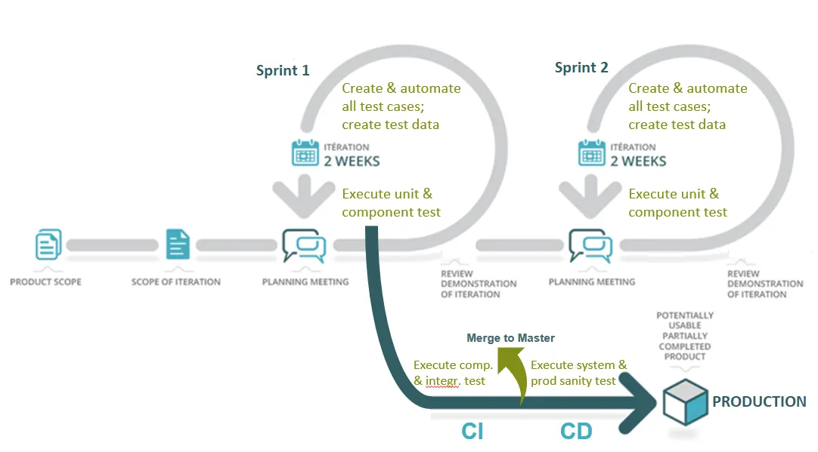
Deployment Methodology – Iterative/ Incremental
DevOps Tech Stack
CI/CD: Jenkins for continuous integration and deployment.
Version Control: Git for source code management.
Containerization: Docker for containerization of microservices.
Orchestration: Kubernetes for container orchestration.
Monitoring: Prometheus and Grafana for monitoring and visualization.
Infrastructure as Code: Terraform for provisioning infrastructure.
Application Security tool like Sonar, OWSP ZAP to verify that the applications are secure before release.

Slide 11
Governance Mechanism
KPI
Steering Committee
Governing Layer
Velocity
Team's productivity and predictability
Burnup/burndown
Velocity
Lead Time
Throughput
Quality
Degree of excellence of the pod's output
Defects#
Coverage
Defect distribution
Build Stability
Directing Layer
Product Owner
Solution Provider
Manging Layer
Product Impact
Business Value and impact generated
Reduced technical debt and vulnerabilities
Improved exception handling and resilience
Improved agility and faster release cycles
Autonomy
Mature of the team's operations
Core team ratio
Technical Debt
Scope delta ratio
Process Suggestion
Business Manager
Project Manager
Performing Layer
Business Representative
Project Core Team

Slide 12
Timeline & Key Assumptions
Activity | Q4-2024 | Q1-2025 | Q2-2025 | Q3-2025 | Q4-2025
Planning Discovery & Prioritization
Development & Deployment Next Gen Portal (MVP)
Enhancement & Scaling
User & Data Migration
Key Assumptions
Scope limited to functional and business capabilities for Retail Banking only
Unique Bank to identity key stakeholders and provide relevant documentation at least 1 week prior to kick-off
﻿﻿It is assumed that the key stakeholders in Core team will be able to spend the required time for interviews and workshops.
Any deviation in the plan, will have an impact on the overall timelines.
Existing branding and style guidelines will be used and provided at the start of the engagement that includes fonts, colours, logos, and imagery including usage guidelines.
QA team will execute testcases on 4 desktop browsers and on 2 browsers on mobile devices - IOS & Android
Web Ul (7- End to End Flows) and API(15 APIs) are considered in scope for Performance testing.
Web application DAST/Pen-Testing, SAST and Web Services DAST will be executed as part of security testing.
Project Manager
Business Analyst
Solution Architect
Test Manager
UI/UX Manager
Project Manager
Business Analyst
Solution Architect
Test Manager
UI/UX Manager
Dev Lead
Developer
Tester
DevOps Engg
SRE Engg
Project Manager
Business Analyst
Solution Architect
Test Manager
UI/UX Manager
Dev Lead
Developer
Tester
DevOps Engg
SRE Engg
Project Manager
Business Analyst
Solution Architect
Data Team
Test Manager
Dev Lead
Developer
Tester
DevOps Engg
SRE Engg

Slide 13
Thank You

